Slide 1
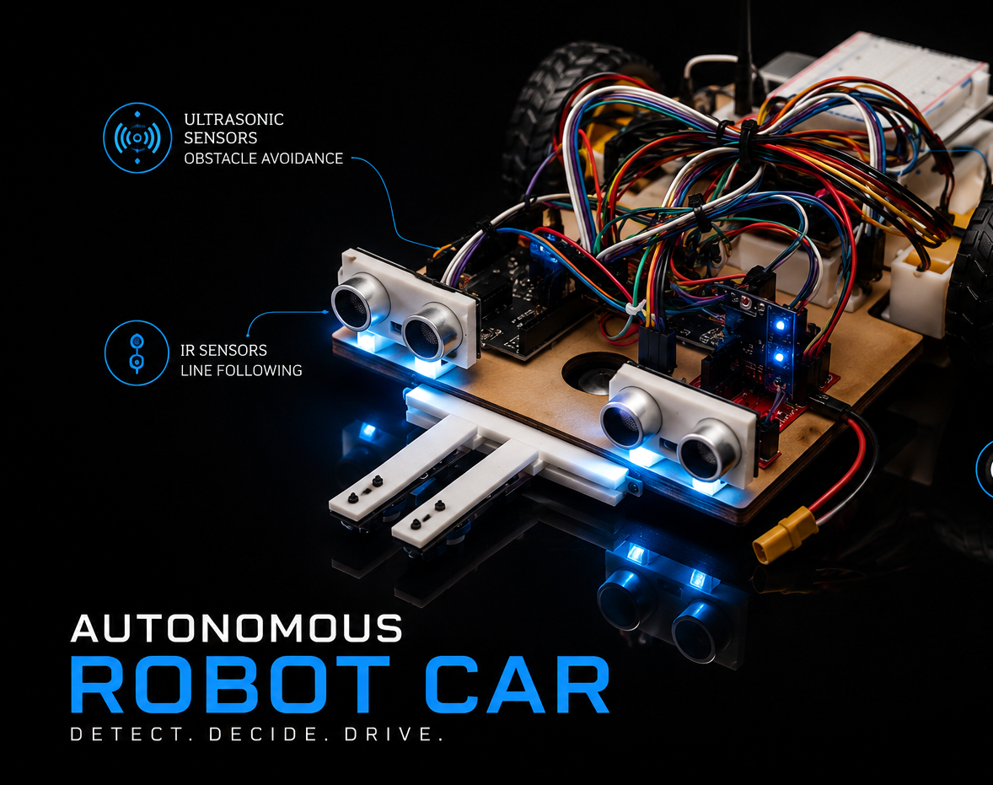
Autonomous Robot Car Team - E2-E5
Team Members : Shamal Chathura Gamlath Kankanamalage
Deemana Dewmini Mirihella Adikaramalage
Shehan Nihindu Thenuka Liyanage
Ishan Wickramathunga
Shamal Gamlath

Slide 2
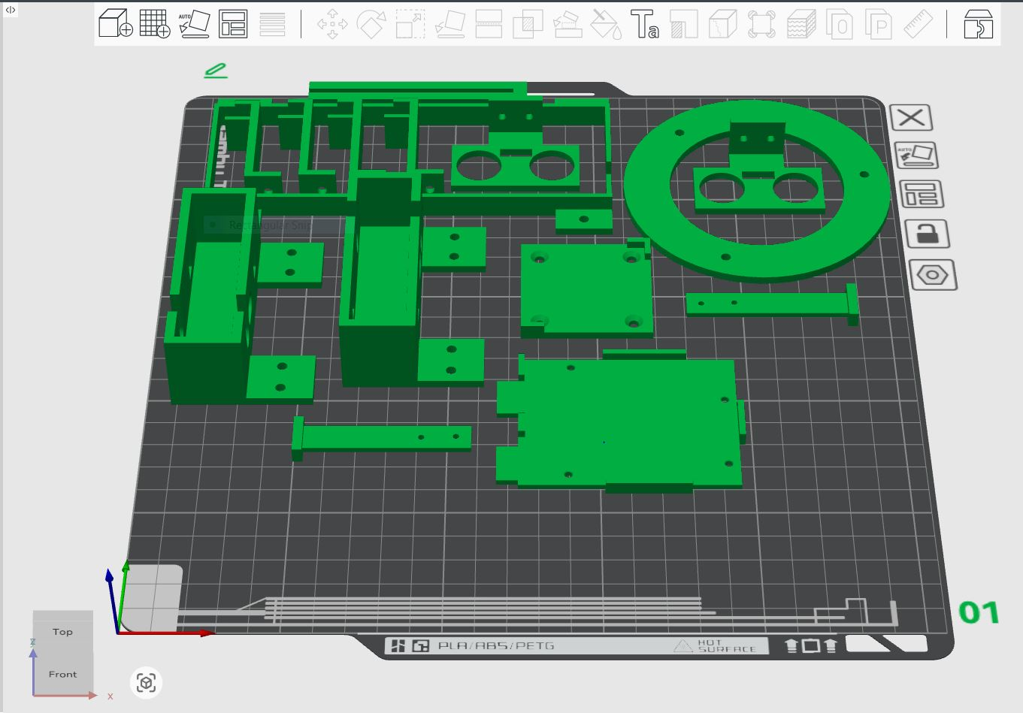
3D Models
3D Modeling: Developed the initial designs in SolidWorks to ensure precise specifications.
Prototyping: Fabricated the physical components using 3D printing for evaluation.
Shamal Gamlath

Slide 3
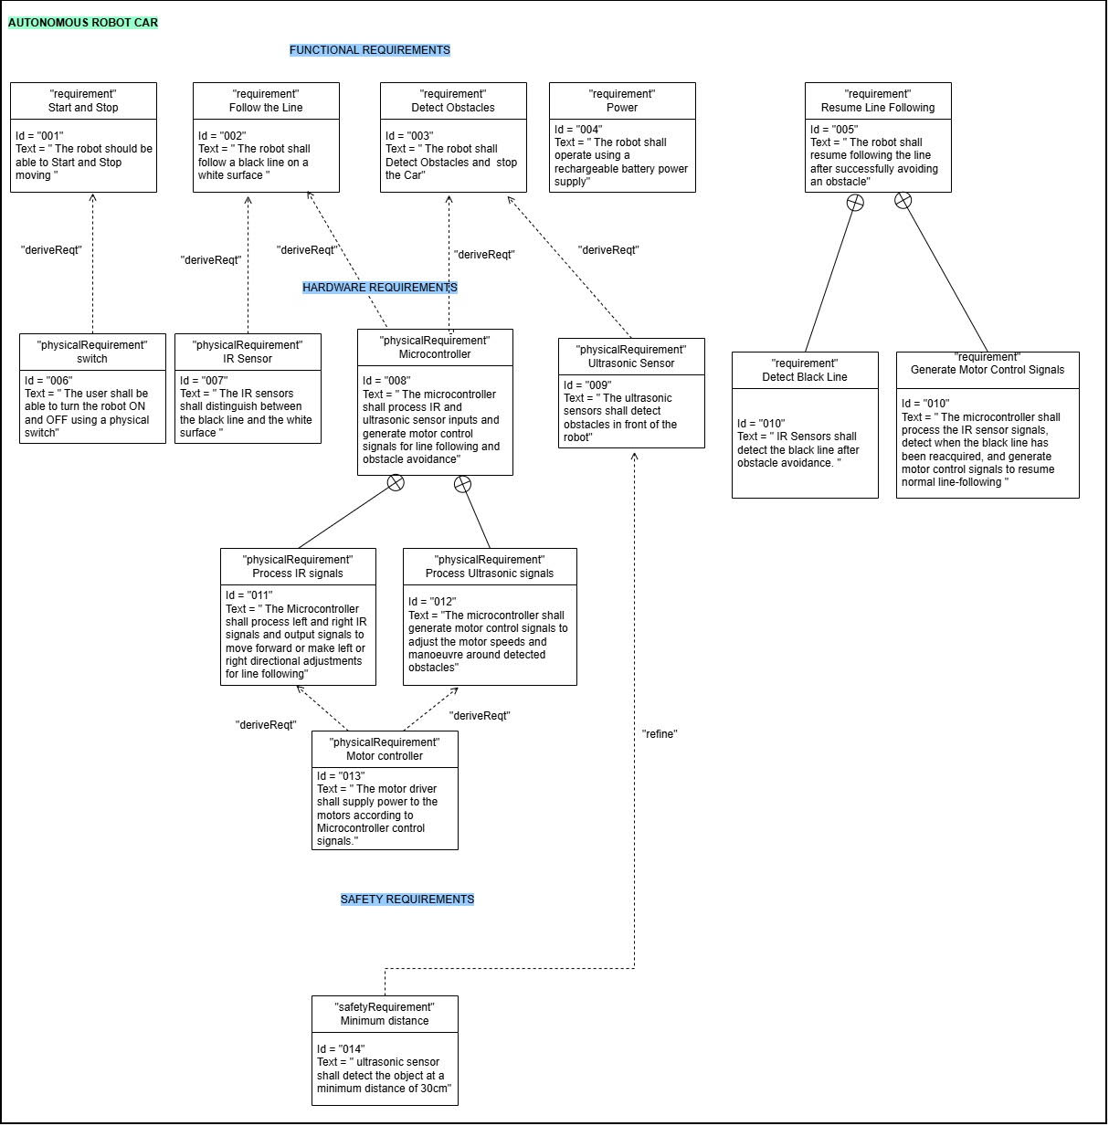
Requirement Diagram
System Analysis: Defined all functional and non-functional requirements.
Requirements Modeling: Developed a requirements diagram to visualize and align project specifications.
Shehan Liyanage

Slide 4
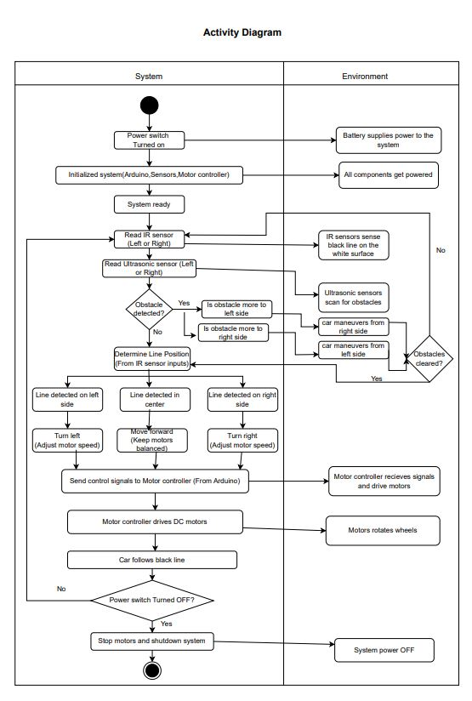
Activity Diagram
Task Identification: Defined the specific objective tasks required for the system.
Activity Modeling: Built an activity diagram to visualize and map out the operational workflow.
Shehan Liyanage

Slide 5
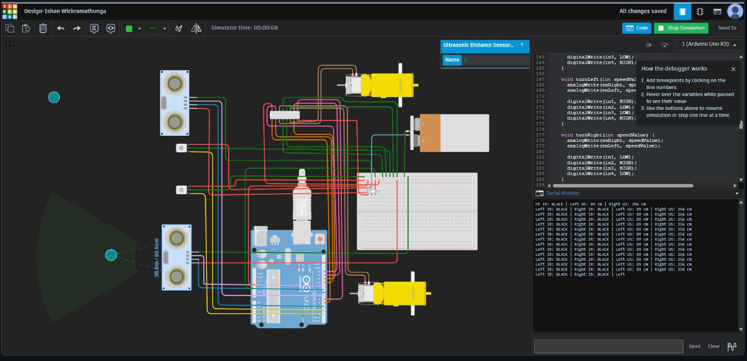
Simulated Circuit Design
Circuit Design: Developed and mapped the schematic layout within TinkerCAD.
Simulation: Evaluated system behavior and verified the design before physical assembly.
Ishan Wickramathunga

Slide 6
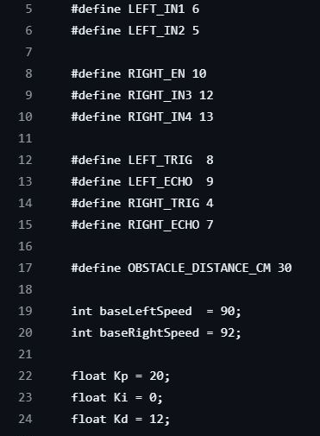
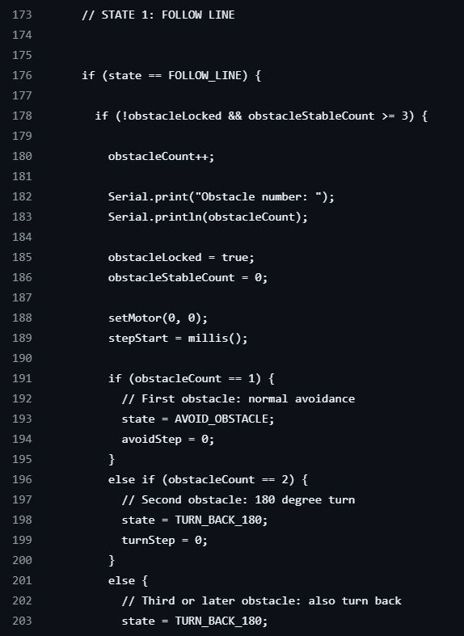
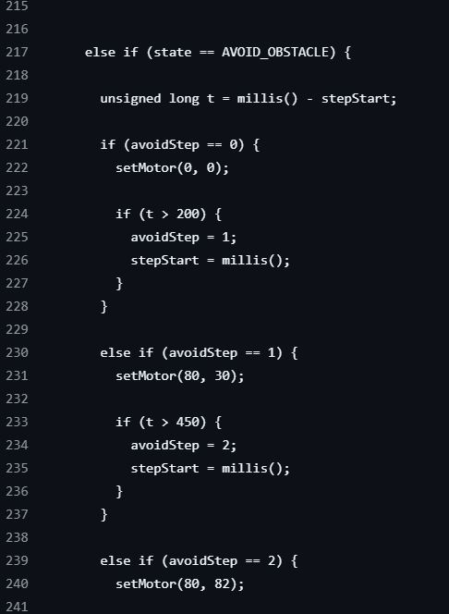
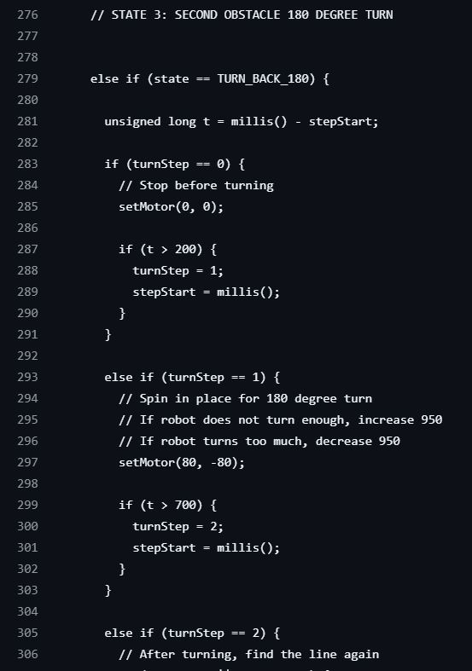
Coding
Line Following: Automated precise path navigation.
Obstacle Avoidance: Implemented active sensor tracking to detect and bypass the first barrier.
Dynamic Maneuvering: Programmed a precise 180° turn to navigate the second obstacle.
Ishan Wickramathunga

Slide 7
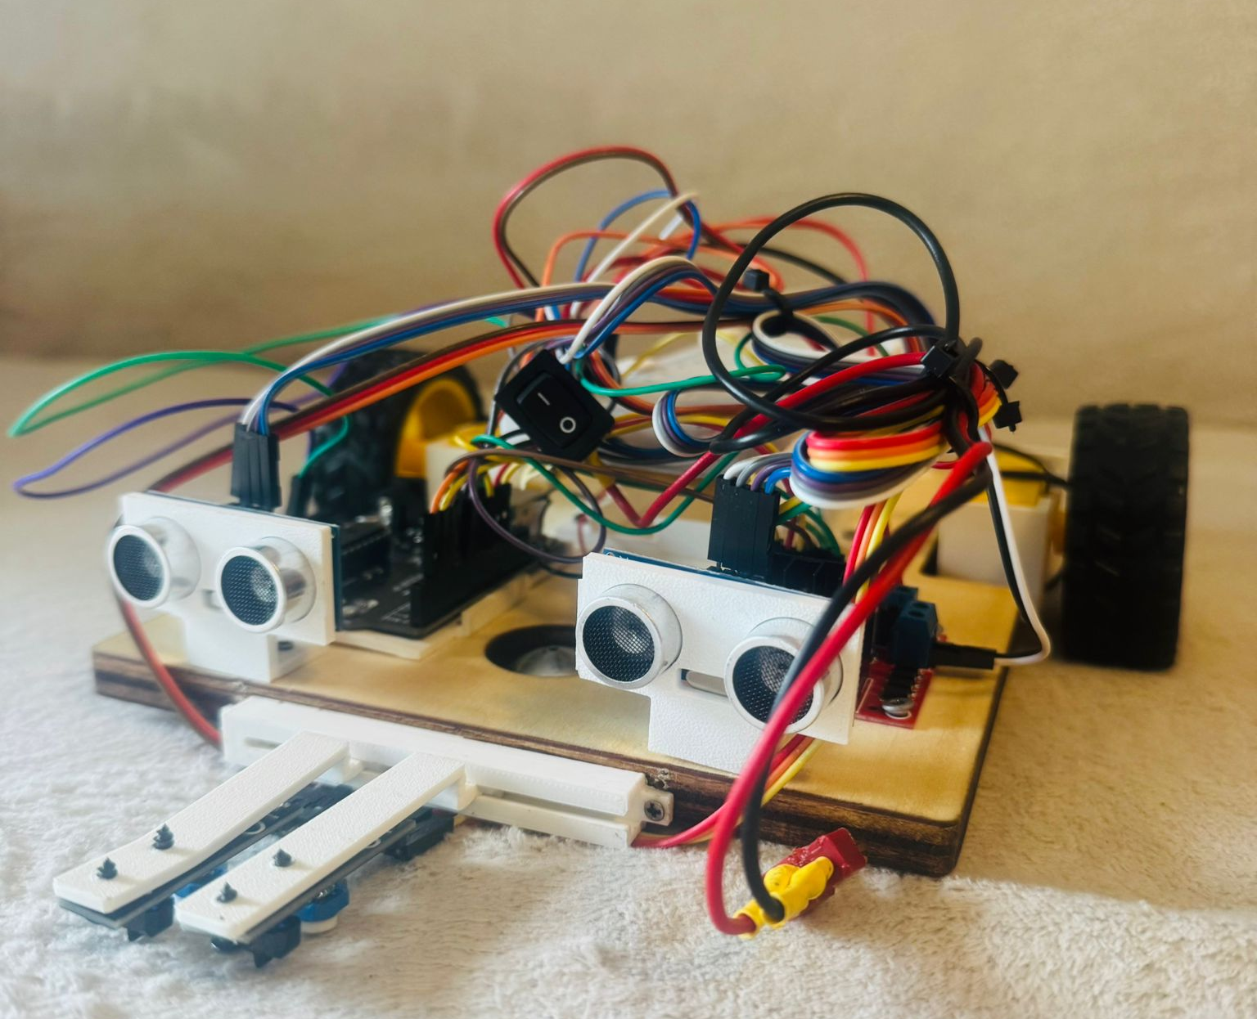
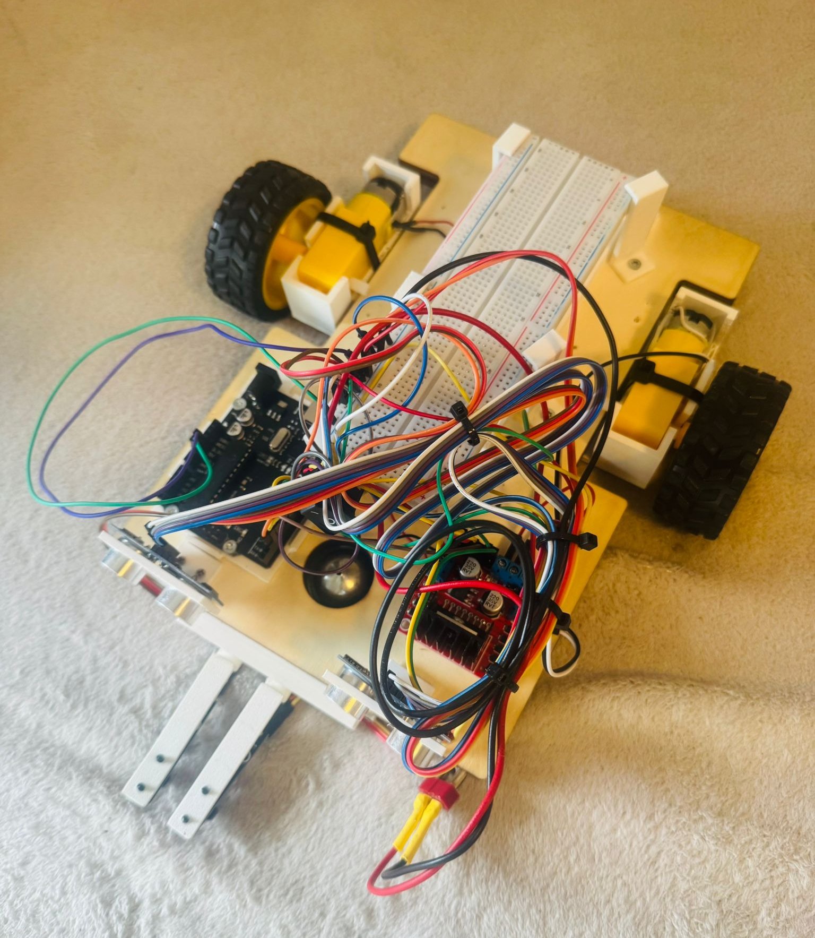
Final Product
System Integration: Combined the mechanical, electrical, and software components into a fully functional unit.
Validation: Verified that the completed prototype successfully meets all design requirements and project objectives.
Deemana Mirihella

Slide 8

Any Questions?
Deemana Mirihella

